Slide 16
Notes:
Simulations
Similar to showing multiple outcomes, seeing various results occur one-by-one to build up an overall picture provides intuition for the fuzziness of predictions.
Pros
When data appears all at once or in aggregate, it can be a challenge for many to interpret results and link it back to what the data actually represents. By showing simulations, you get a sense of build-up and a link with individual outcomes.
Cons
Too much weight might be placed on individual outcomes which obscures the overall picture.
From flowingdata.com

Slide 18
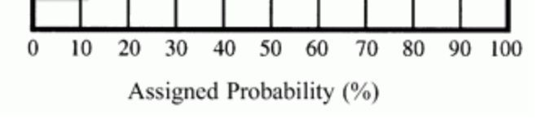
ACTIVITY
Uncertainty vs. Certainty

Slide 19
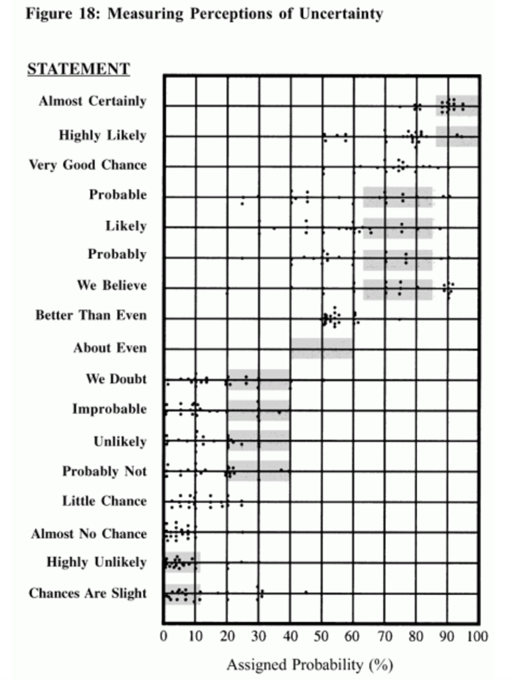

Slide 20
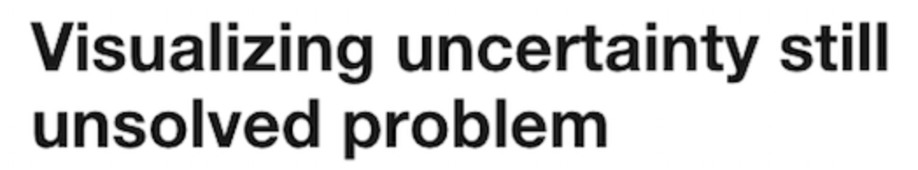

Slide 21
Data from an experiment may appear rock solid. Upon further examination, the data may morph into something much less firm. A knee-jerk reaction to this conundrum may be to try and hide uncertain scientific results, which are unloved fellow travelers of science.

Slide 22
After all, words can afford ambiguity, but with visuals, “we are damned to be concrete,” says Bang Wong, who is the creative director of the Broad Institute of MIT and Harvard. The alternative is to face the ambiguity head-on through visual means.

Slide 29
Notes:
Probably around .05

Slide 30
Notes:
Probably greater than .05

Slide 31
Notes:
Probably less than .05

Slide 35
